Slide 1
Software Development with UML and Java 2
Assignment 2

Slide 2
Assignment 2

Slide 3
Similar to the Burger bar exercise last time
Topics:
RMI
Unit testing
Producer/consumer, blocking queue
Proxy
Adapter

Slide 4
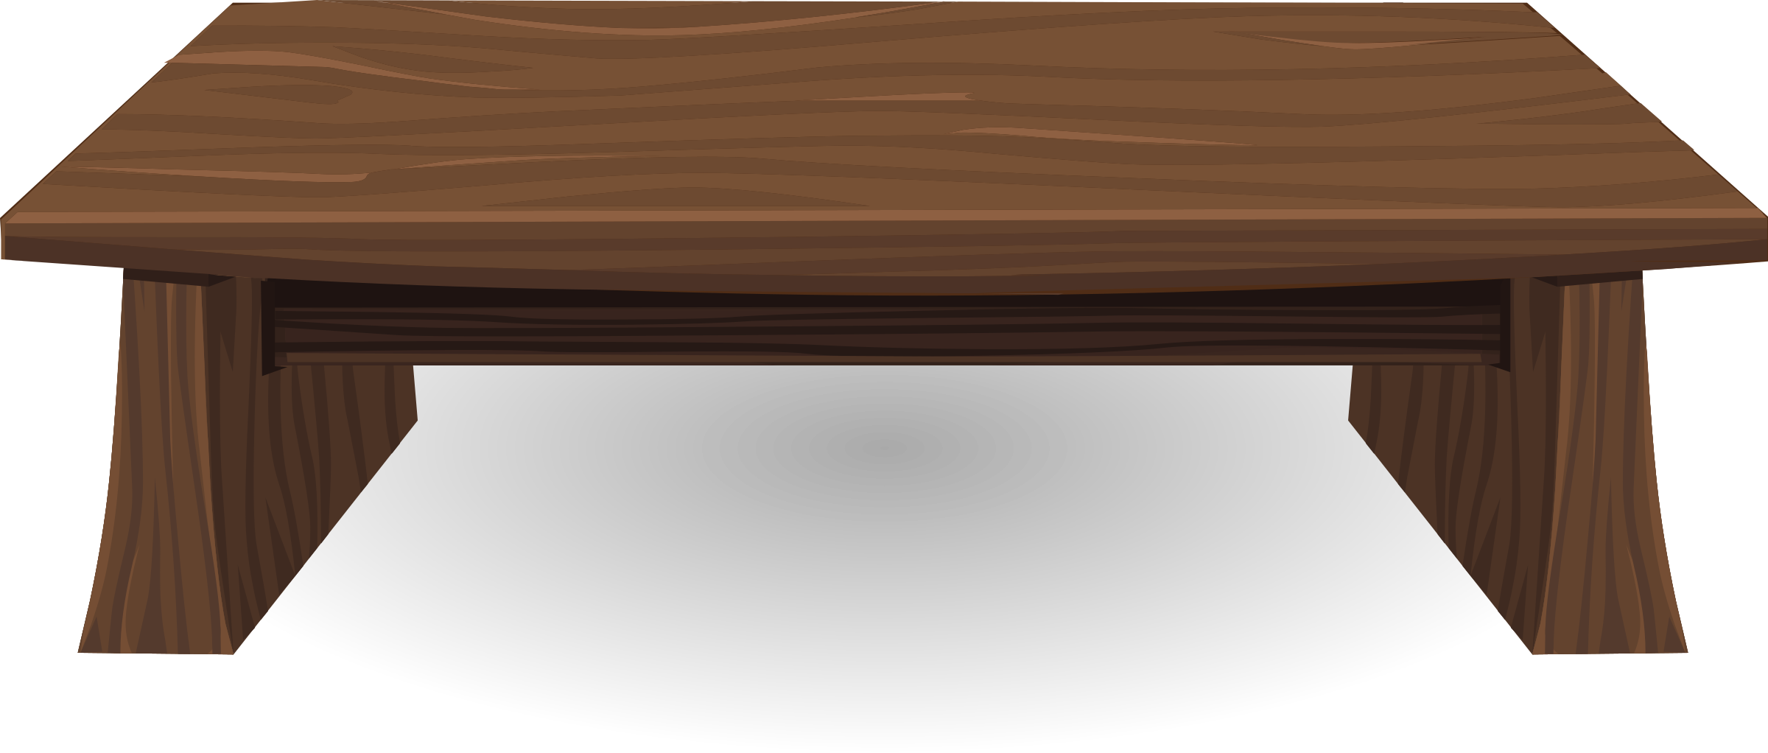









Troels’ Burger Joint

Slide 5
Troels’ Burger Joint

Slide 6
Troels’ Burger Joint

Slide 7
Troels’ Burger Joint

Slide 8
Troels’ Burger Joint

Slide 9
Troels’ Burger Joint

Slide 10
Troels’ Burger Joint

Slide 11
Troels’ Burger Joint

Slide 12
Troels’ Burger Joint

Slide 13
Troels’ Burger Joint

Slide 14
Troels’ Burger Joint

Slide 15
Chef Client
Customer Client
Proxy
Burgerbar Manager
Recipe
Burgerbar (Server)
Blocking Queue
ArrayList

Slide 16
Chef Client
Customer Client
Proxy
Burgerbar Manager
Recipe
Burgerbar (Server)
Blocking Queue
Intentionally fluffy diagram
ArrayList

Slide 17
Chef Client
Customer Client
Proxy
Burgerbar Manager
Recipe
Burgerbar (Server)
Blocking Queue
You’re given an ArrayList.
Unit test this.
ArrayList

Slide 18
Chef Client
Customer Client
Proxy
Burgerbar Manager
Recipe
Burgerbar (Server)
Blocking Queue
Use the adapter pattern to make the ArrayList into a BlockingQueue.
It contains Burgers made by Producer client
ArrayList

Slide 19
Chef Client
Customer Client
Proxy
Burgerbar Manager
Recipe
Burgerbar (Server)
Blocking Queue
RMI server, has reference to a Blocking Queue
ArrayList

Slide 20
Chef Client
Customer Client
Proxy
Burgerbar Manager
Recipe
Burgerbar (Server)
Blocking Queue
RMI client. This client will continuously retrieve Burgers from the Server.
ArrayList

Slide 21
Chef Client
Customer Client
Proxy
Burgerbar Manager
Recipe
Burgerbar (Server)
Blocking Queue
RMI client. This client will continuously make Burgers and send to the server
ArrayList

Slide 22
Chef Client
Customer Client
Proxy
Burgerbar Manager
Recipe
Burgerbar (Server)
Blocking Queue
The producer will randomly make 1 of 3 types of burger. Through a RecipeProvider, a Recipe can be loaded. Through this Recipe you can get a Burger object.
ArrayList

Slide 23
Chef Client
Customer Client
Proxy
Burgerbar Manager
Recipe
Burgerbar (Server)
Blocking Queue
The Recipe is read from file. Use the proxy pattern to create a cache:
Store the last recipe in the Proxy, so it may be reused if needed, instead of reading from the file again.
ArrayList

Slide 24
Chef Client
Customer Client
Proxy
Burgerbar Manager
Recipe
Burgerbar (Server)
Blocking Queue
The Burgerbar Manager is the third client. There must be a very simple GUI (no mvvm necessary). When a button is clicked, the Burger bar should close.
This means, the Chefs should stop making burgers, and the Customers must stop taking burgers.
ArrayList

Slide 25
Chef Client
Customer Client
Proxy
Burgerbar Manager
Recipe
Proxy
Burgerbar (Server)
RMI
Adapter
Blocking Queue
Unit test
ArrayList
Blocking queue

Slide 26


Slide 27
Provided code
ArrayList
Recipe-stuff
Links in the assignment document

Slide 28
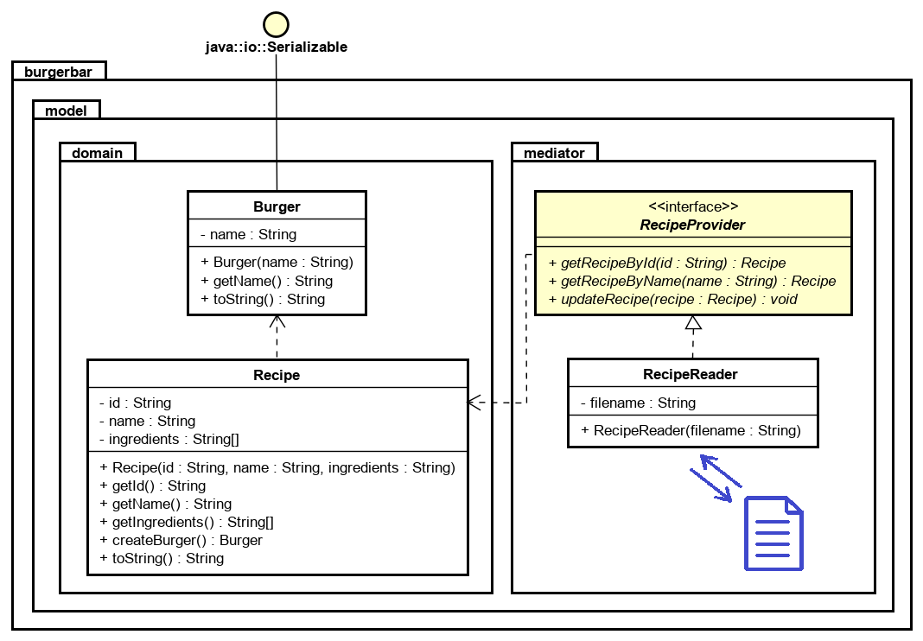
Provided Code
Your System
Send this to the Server
Used to load a Recipe
Used to make a Burger
Proxy

Slide 29
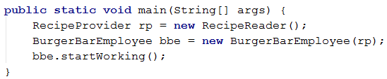
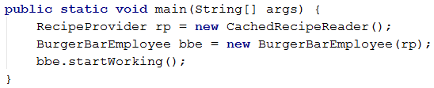
Producer Constructor
As argument, take a RecipeProvider (the interface)
For example:
BurgerBarEmployee (the provider client) just knows about the interface.
Later, when the proxy is created, just use this instead.

Slide 30


Slide 31
Experience from last time
Try to define the various requirements, and focus on one thing at a time, instead of working all over the place.

